Slide 1
DDSAnalytics Employee Data Analysis
Halle Purdom

Slide 2
Overview
Looking at the data
What leads to employee turnover?
Building a model to predict employee salary

Slide 3
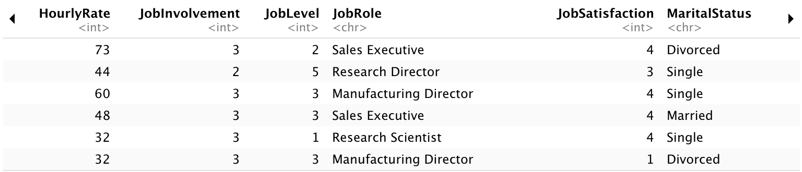
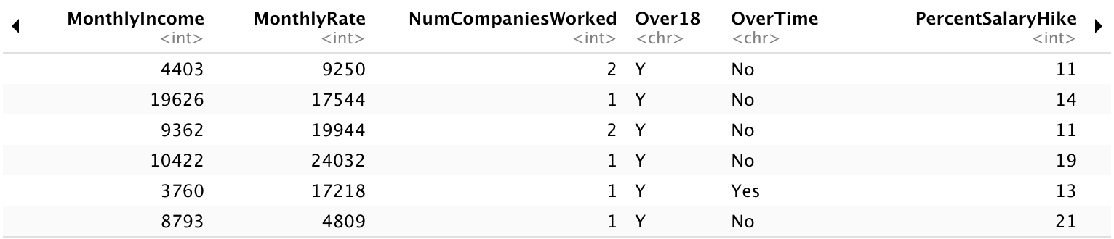
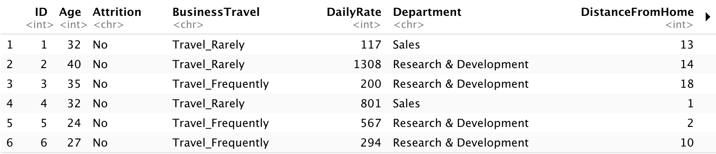
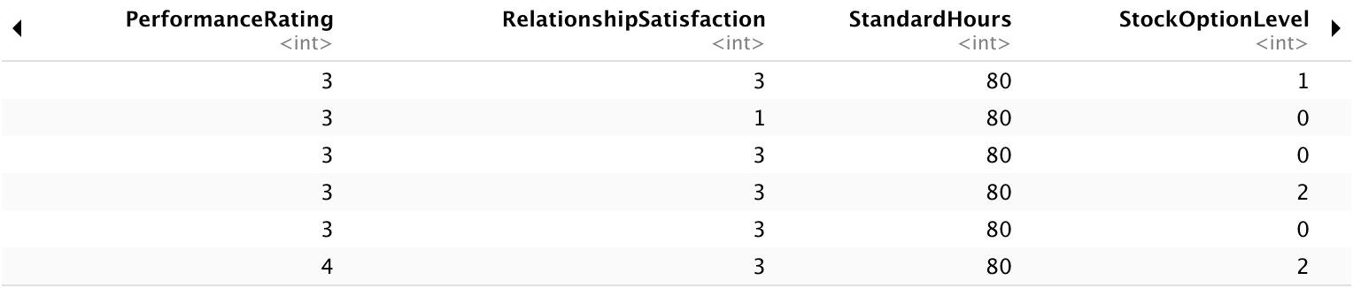
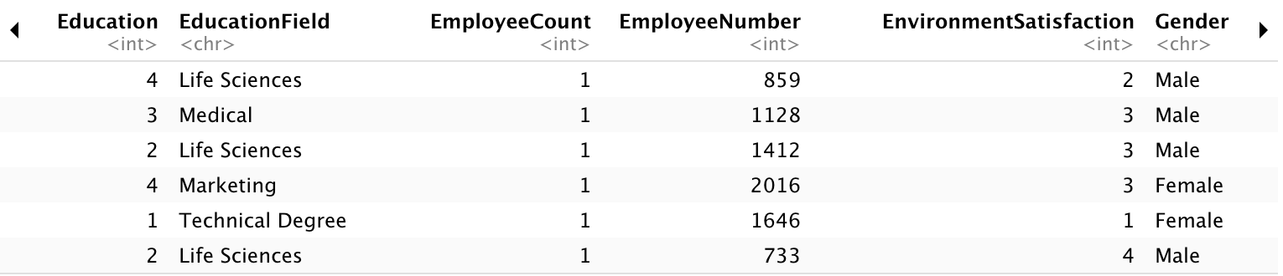
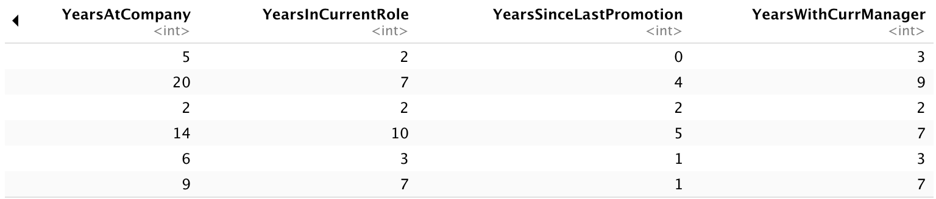
1. Looking at the data
870 observations (employees)
36 variables
27 variables are integers
Attrition
Monthly Income
9 are characters

Slide 4
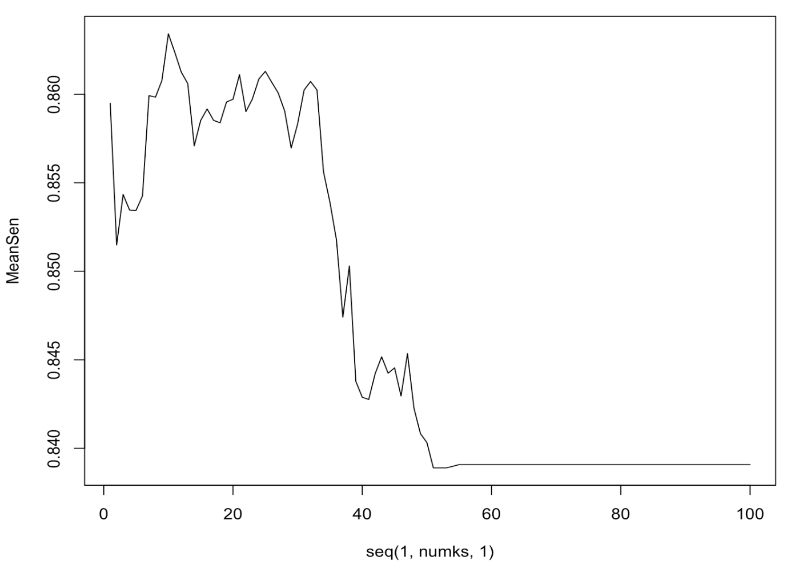
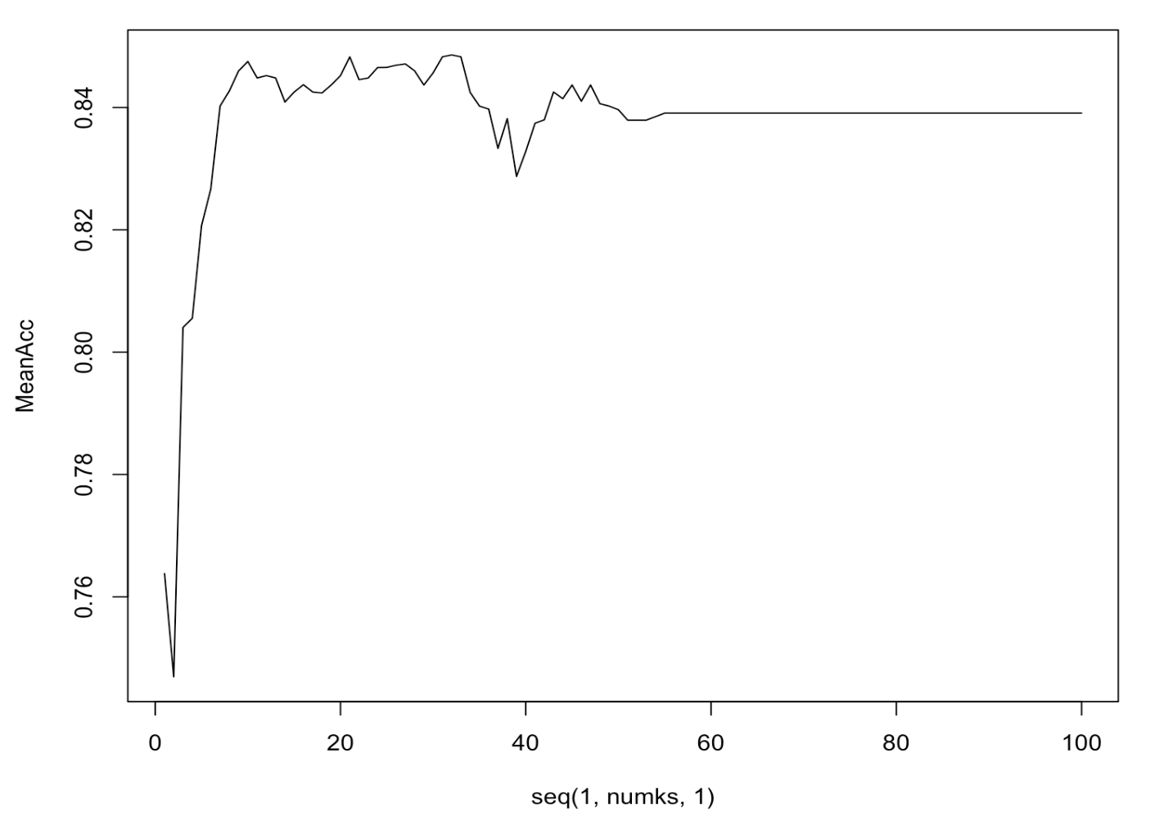
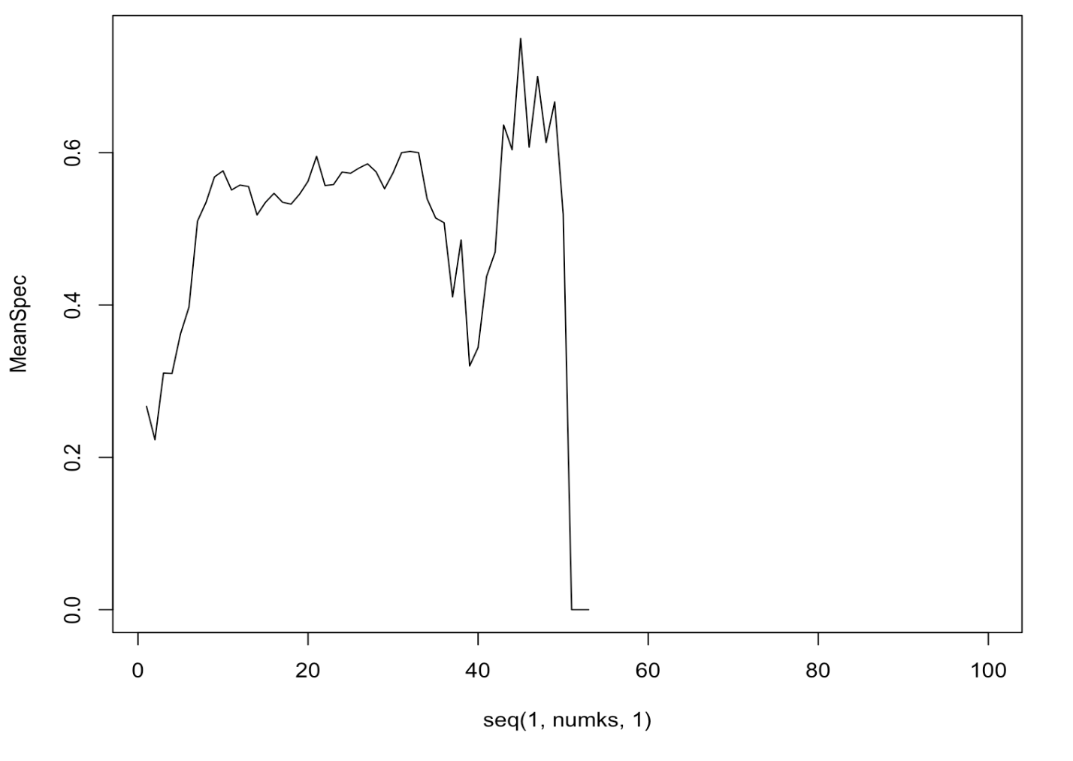
2. What leads to employee turnover?
K-NN Classification Method
Internal Cross Validation
Finding the best k=45
Accuracy 0.8436782
Sensitivity 0.8445476
Specificity 0.75
Max Sensitivity = 10
Range from 0.83-0.87
Max Accuracy = 32
Range from 0.75-0.85
Max Specificity = 45
Range from 0-0.8

Slide 5
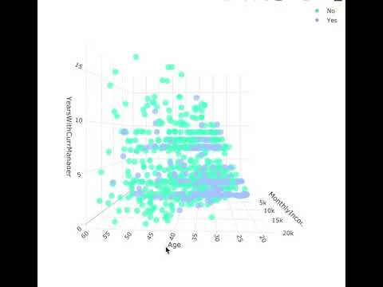
2. What leads to employee turnover?
Standardization
3 Variables of Interest
MonthlyIncome
YearsWithCurrManager
Age
3D Model
Teal:
Attrition = No
Blue:
Attrition=Yes

Slide 6
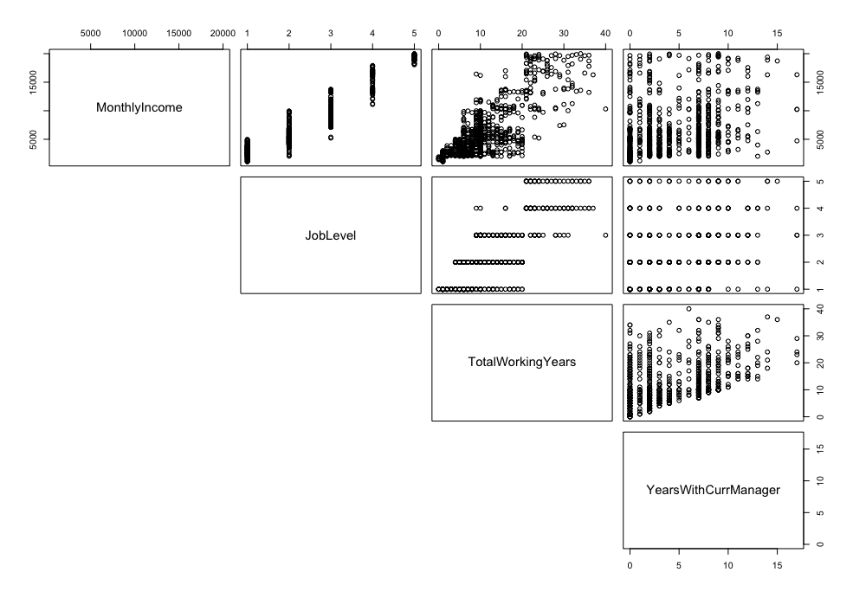
3. Building a model to predict salary
Multiple Linear Regression Model
Pred MonthlyIncome = β₀ + β₁JobLevel + β₂TotalWorkingYears + β₃YearsWithCurrManager
Coefficients
β₀= -1699.16
β₁= 3717.24
β₂= 68.34
β₃= -59.33
RMSE = $1374.498
Adjusted R² = 0.9102
Notes:
What is RMSE: how concentrated the data is around the regression line
What is Adj R2: proportion of the variance for Salary that's explained by the independent variables, adjusted accounts for the amoutn of predictors

Slide 7
Conclusion
What 3 variables lead to employee turnover/attrition?
Age, Monthly Income, and Years with Current Manager
45-nn model can predict this with 84% Accuracy
Building a model to predict Monthly Income
MLR Model: Job Level, Total Working Years, and Years with Current Manager
RMSE = $1374.498

